Slide 1
Web User Interface and Using Page Templates
(Section 9)

Slide 2
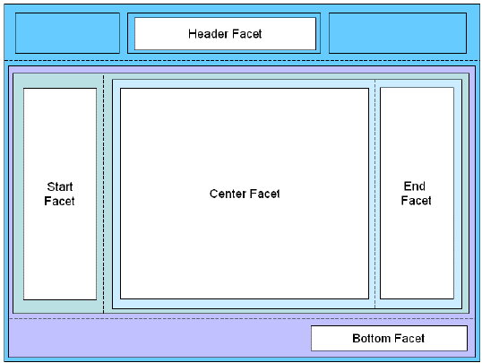
Page Templates
To ensure consistency throughout your application, you use ADF page templates. These page templates provide structure and consistency for other developers building web pages. Page templates typically contain static areas which cannot be changed when they are used, and dynamic areas, where developers can place content specific to the page they are building.

Slide 3
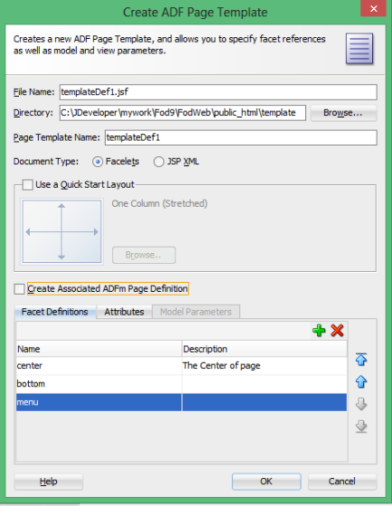
Creating Page Template
In Web Content Right Click ->
new ->
web Tier ->
Jsf/Facelets ->
Adf Page Templatea
Enter the desire facets , attributes

Slide 4

Creating Page Template
Page Template xml Content
<af:pageTemplateDef> <af:xmlContent> <afc:component> <afc:facet> <afc:facet-name>center</afc:facet-name> </afc:facet> <afc:attribute> <afc:attribute-name> showMenu </afc:attribute-name> <afc:attribute-class> boolean </afc:attribute-class> <afc:default-value> true </afc:default-value> </afc:attribute> </afc:component> </af:xmlContent> </af:pageTemplateDef> | Using Facets in Page Template : <af:panelStretchLayout id="pt_psl1" topHeight="130px" endWidth="200px"> <f:facet name="center"> <af:panelGroupLayout id="pt_pgl4" layout="scroll"> <af:facetRef facetName="center"/> </af:panelGroupLayout> </f:facet> </af:panelStretchLayout>
 | Using Attribute in Page Template : <af:panelGroupLayout id="pt_pgl2" layout="scroll" rendered="#{attrs.showMenu}"> …

Slide 5
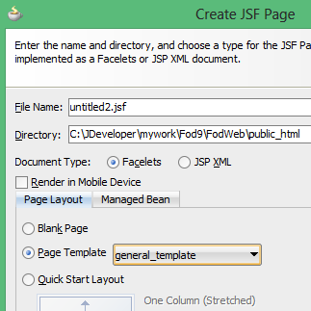
Using Page Templates
For using your page template in pages choose
page Template wile creating page then design
your page in defined facests.
<af:document title="home.jsf" id="d1">
<af:messages id="m1"/>
<af:form id="f1">
<af:pageTemplate viewId="/template/general_template.jsf" id="pt1">
<f:facet name="center">

Slide 6
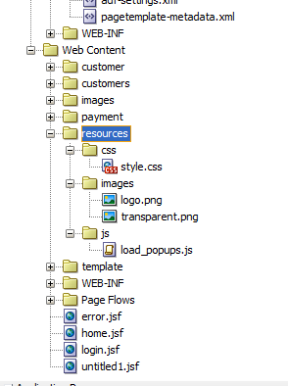
Resources (library) in JSF 2.0
In JSF 2.0, all your web resources files like css, images or JavaScript, should put in “resources” folder, under the root of your web application (same folder level with “WEB-INF“).
The sub-folder under “resources” folder is consider as “library” or “project theme“, later you can reference those “resources” with library attribute.
El Expression To access an image : #{resource['images:logo.png']}
images: library
logo.png : resource

Slide 7
Change the Pages as Right To Left
Adf Faces (Apache Trinidad) is configured with an trinidad-config.xml file. If you need an trinidad-config.xml file then it must be placed in the WEB-INF directory of your web application. This file has a very simple XML structure that relies on the JSF expression language (EL) for flexibility.
The <right-to-left> element defines whether pages will be rendered in left-to-right or right-to-left mode.
<trinidad-config xmlns="http://myfaces.apache.org/trinidad/config">
<right-to-left>true</right-to-left>
</trinidad-config>

